Slide 1
Welcome to Greyhoundderby Quiz 11

Slide 2
Target
This quiz consists of 8 rounds based on 8 former TV shows. In the first 7 rounds you should try to accumulate as many points as possible.
In round 8, Winner Takes All, you are asked a question and given 5 possible answers. You can stake up to half the points you own on one of the answers. If correct you win that number of points, but an incorrect answer loses you the points you staked.
Your overall target is 20,000 points.

Slide 3
Celebrating TV Quiz Shows
A Question of Sport
University Challenge
Sale of the Century
Double your Money
Family Fortunes
Generation Game
Pointless
Winner Takes All

Slide 4
A Question of Sport 2nd December 1968 – present day

Slide 5
Target
In this section you are asked 20 questions.
Your target is 300 points.

Slide 6
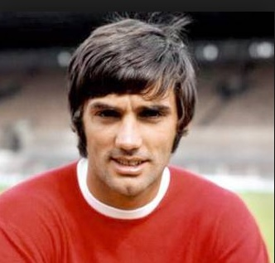
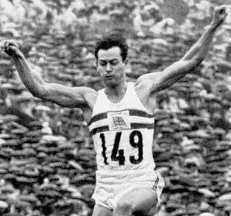
Question of Sport Celtic Sports Stars 10 pts per competitor (Bonus 10 pts for Ireland, Scotland or Wales)
1 | 2

Slide 7
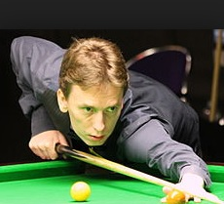
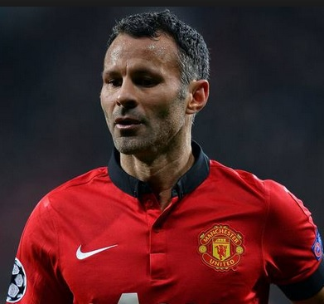
Question of Sport Celtic Sports Stars 10 pts per competitor (Bonus 10 pts for Ireland, Scotland or Wales)
3 | 4

Slide 8
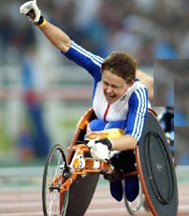
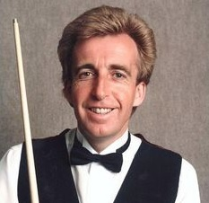
Question of Sport Celtic Sports Stars 10 pts per competitor (Bonus 10 pts for Ireland, Scotland or Wales)
5 | 6

Slide 9
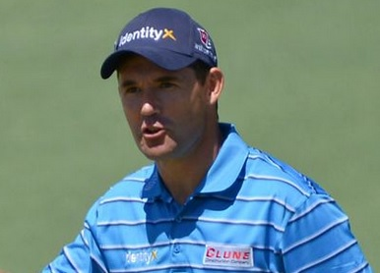
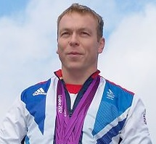
Question of Sport Celtic Sports Stars 10 pts per competitor (Bonus 10 pts for Ireland, Scotland or Wales)
7 | 8

Slide 10
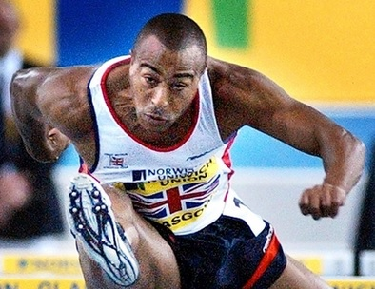
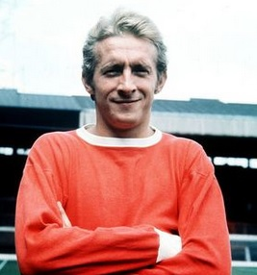
Question of Sport Celtic Sports Stars 10 pts per competitor (Bonus 10 pts for Ireland, Scotland or Wales)
9 | 10

Slide 11
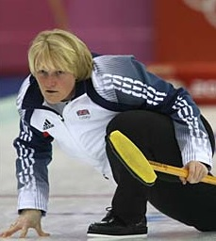
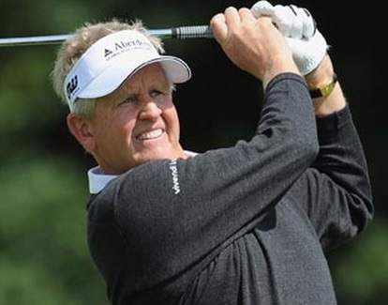
Question of Sport Celtic Sports Stars 10 pts per competitor (Bonus 10 pts for Ireland, Scotland or Wales)
11 | 12

Slide 12
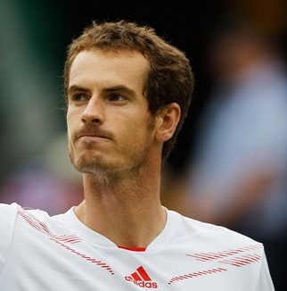
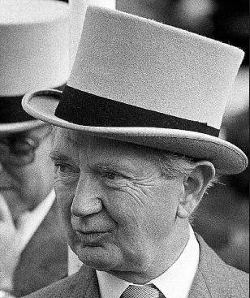
Question of Sport Celtic Sports Stars 10 pts per competitor (Bonus 10 pts for Ireland, Scotland or Wales)
13 | 14

Slide 13
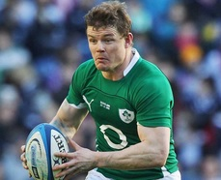
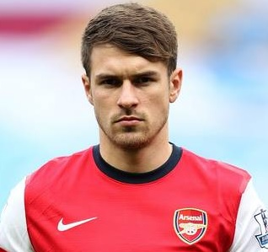
Question of Sport Celtic Sports Stars 10 pts per competitor (Bonus 10 pts for Ireland, Scotland or Wales)
15 | 16

Slide 14
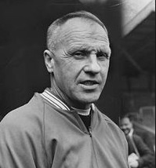
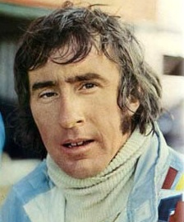
Question of Sport Celtic Sports Stars 10 pts per competitor (Bonus 10 pts for Ireland, Scotland or Wales)
17 | 18

Slide 15
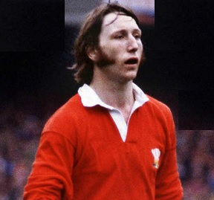
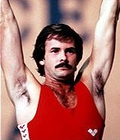
Question of Sport Celtic Sports Stars 10 pts per competitor (Bonus 10 pts for Ireland, Scotland or Wales)
19 | 20

Slide 16
10 pts per competitor + 10 pts per country
1 | George Best | Ireland | 11 | Rhona Martin | Scotland
2 | Lynn Davies | Wales | 12 | Colin Montgomerie | Scotland
3 | Ken Doherty | Ireland | 13 | Andy Murray | Scotland
4 | Ryan Giggs | Wales | 14 | Vincent O’Brien | Ireland
5 | Tanni Grey-Thompson | Wales | 15 | Brian O’Driscoll | Ireland
6 | Terry Griffiths | Wales | 16 | Aaron Ramsey | Wales
7 | Padraig Harrington | Ireland | 17 | Bill Shankley | Scotland
8 | Chris Hoy | Scotland | 18 | Jackie Stewart | Scotland
9 | Colin Jackson | Wales | 19 | J P R Williams | Wales
10 | Denis Law | Scotland | 20 | David Wilkie | Scotland

Slide 17
Target
Did you meet, or even surpass, the target of 300 points?
Your target in the next round is also 300 points, meaning you should aim for 600 points by the end of round 2.

Slide 18
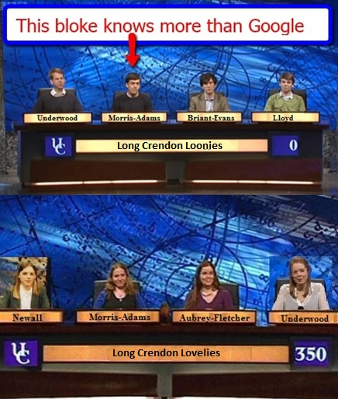
University Challenge 1962-1987 & 1994- present

Slide 19
University Challenge Which of these islands are larger in area than the Isle of Man (221 Sq Miles)? 30 pts per correct answer; TOTAL SCORE OF ZERO on this round for even one incorrect answer.
Corfu | Lanzarote
Corsica | Malta
Crete | Mauritius
Cyprus | Minorca
Ibiza | Mull
Islay | Orkney (mainland)
Isle of Wight | Shetland (mainland)
Jamaica | Sicily
Java | Tasmania
Kefalonia | Trinidad

Slide 20
University Challenge Which of these islands are larger in area than the Isle of Man (221 Sq Miles)? 30 pts per correct answer; TOTAL SCORE OF ZERO on this round for even one incorrect answer.
Corfu 229 | Lanzarote 327
Corsica 3351 | Malta 122
Crete 3224 | Mauritius 709
Cyprus 3572 | Minorca 268
Ibiza 220 | Mull 338
Islay 239 | Orkney (mainland) 202
Isle of Wight 147 | Shetland (mainland) 374
Jamaica 4320 | Sicily 9908
Java 53,589 | Tasmania 24,911
Kefalonia 301 | Trinidad 1864

Slide 21
Target
Did you manage at least 300 points on that round?
Have you met, or even surpassed, the overall target of 600 points?
Your target in round 3 is 300 points, meaning your overall target is 900 points.

Slide 22
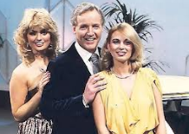
Sale of the Century 1972 - 1983

Slide 23
Sale of the Century
Winners share 2400 pts
4th Round losers 300 pts
3rd Round losers 200 pts
2nd Round losers 100 pts
First Round losers 50 pts

Slide 24
John Lewis
All items are taken from the current John Lewis catalogue.
They are items that are used in Summer for garden entertainment.
You have a choice of 3 prices each round.

Slide 25
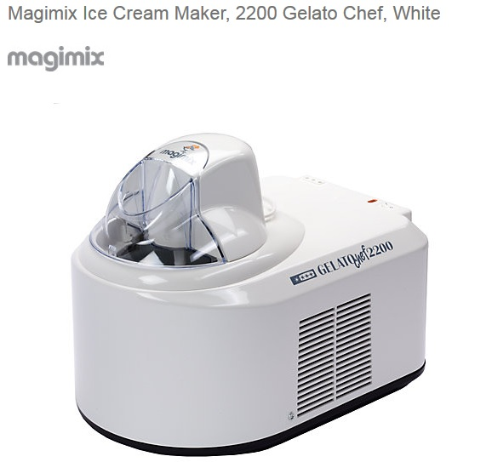
Sale of the Century
A Less than £200 B £200 C More than £200

Slide 26
Ice Cream maker
A £194.99
Losers get 50 pts

Slide 27
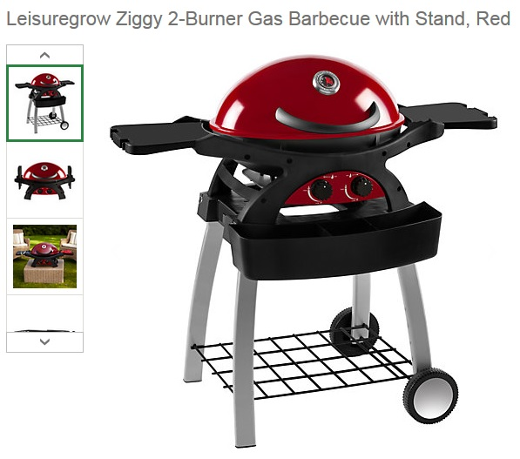
Sale of the Century
A Less Than £349
B £349
C More than £349

Slide 28
Barbecue
B £349
Losers get 100 pts

Slide 29
Sale of the Century
A Less than £600
B £600
C More than £600

Slide 30
Table and Chairs
A £599
Losers get 200 pts

Slide 31
Sale of the Century
A Less than £1000
B £1000
C More than £1000

Slide 32
Outdoor Sofa
A £999
Losers get 300 pts
Winners share £2400 pts

Slide 33
Four correct answers
If you got all 4 correct then you have won 800 points.
Your target in the next round is 800 points, meaning your overall target by the end of this round is 1700 points.

Slide 34
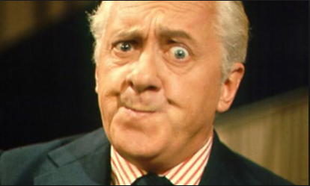
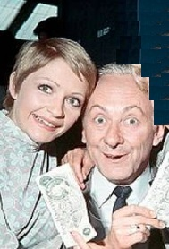
Double Your Money 1955 - 1968
Hughie Green
Monica Rose & Hughie Green

Slide 35
Win from 50 to 6,400 pts
All questions relate to the authors of classics.
Answer 8 questions correctly to win 6,400
You can quit whenever you like to claim your points before the next question is asked.

Slide 36
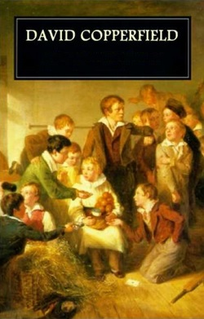
For 50 points
Who wrote this book?

Slide 37
David Copperfield by Charles Dickens
Double or Quits?

Slide 38
For 100 points
Who wrote this book?

Slide 39
Pilgrim’s Progress by John Bunyan
Double or Quits?

Slide 40
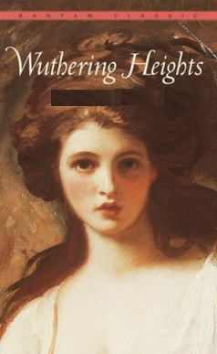
For 200 points
Who wrote this book?

Slide 41
Wuthering Heights by Emily Bronte
Double or Quits?

Slide 42
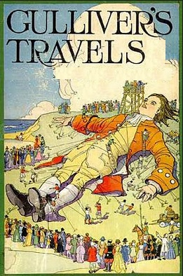
For 400 points
Who wrote this book?

Slide 43
Gulliver’s Travels by Jonathan Swift
Double or Quits?

Slide 44
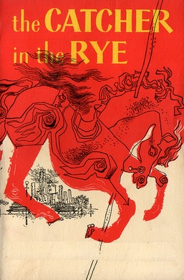
For 800 points
Who wrote this book?

Slide 45
Catcher in the Rye by J.D.Salinger
Double or Quits?

Slide 46
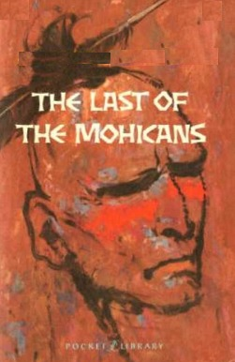
For 1,600 points
Who wrote this book?

Slide 47
The Last of the Mohicans by James Fenimore Cooper
Double or Quits?

Slide 48
For 3,200 points
Who wrote this book?

Slide 49
The Moonshine by Wilkie Collins
Double or Quits?

Slide 50
For 6,400 points
Who wrote this book?

Slide 51
The Phantom of the Opera by Gaston Leroux
Did you hit the jackpot?

Slide 52
Target
Have you met, or even surpassed, the overall target of 1700 points?
Your target, by the end of round 5, is 2500 points.

Slide 53
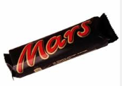
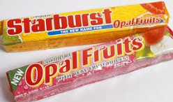
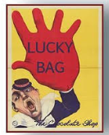
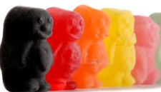
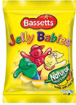
Half way through the show
Lucky

Slide 54
Family Fortunes 1980 - 2002

Slide 55
Family Fortunes
In this section there are 20 possible answers to a particular question.
Stage 1 The topic is given
Stage 2 Each team have to nominate how many answers they will provide.
Stage 3 The question is asked.
Stage 4 The teams record exactly the number of answers they have nominated.
Stage 5 All teams correctly meeting their nominated total receive 50 points per nominated answer.
Any team not meeting their nominated total, or providing an incorrect answer, score ZERO on this round.

Slide 56
Stage 1 The Topic
English Counties

Slide 57
Stage 2
How well do you know the counties which make up England ?
Nominate your target, up to a maximum of 20, to identify.
If you meet your target exactly you will receive 50 pts for each correctly identified answer.

Slide 58
Stage 3
Record the names of any English county which, alphabetically, lies between I and T inclusive.
There are 20 in total.
Only record sufficient to meet your target.

Slide 59
Stage 4
Hand in your answers, ensuring you have only recorded sufficient to meet your target.

Slide 60
Stage 5
Isle of Wight | Nottinghamshire
Kent | Oxfordshire
Lancashire | Rutland
Leicestershire | Shropshire
Lincolnshire | Somerset
Merseyside | South Yorkshire
Norfolk | Staffordshire
Northamptonshire | Suffolk
Northumberland | Surrey
North Yorkshire | Tyne & Wear

Slide 61
Target
Did you meet, or even surpass, the overall target of 2500 points?
Your target, by the end of the next round, is 3500 points.

Slide 62
Generation Game 1971-1982 & 1990 - 2002

Slide 63
Challenge
Look at the next few slides which contain 20 pictures, mainly of fruit.
Once you have seen them all then you must remember as many of them as you can, including how many of each there were.

Slide 64
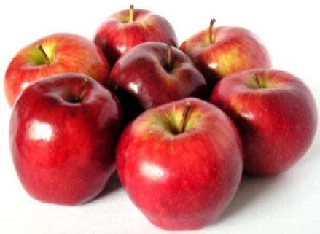
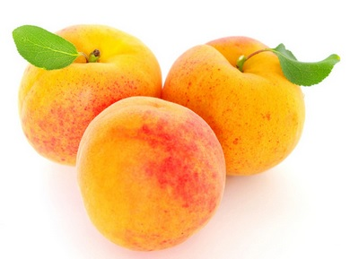
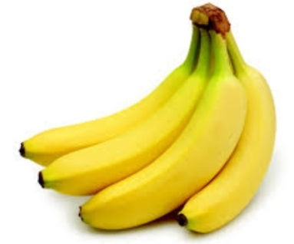
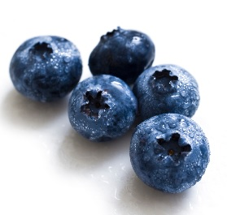
Generation Game Conveyor belt 25 points per item+ Bonuses
Apples | Apricots | Bananas | Blueberry

Slide 65
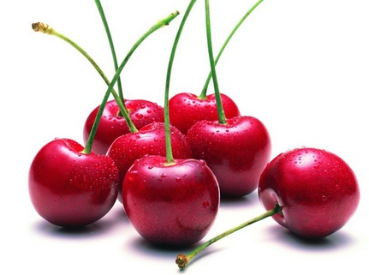
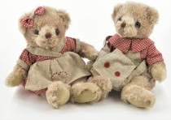
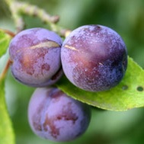
Generation Game Conveyor belt
Cherries | Cuddly toys | Damsons

Slide 66
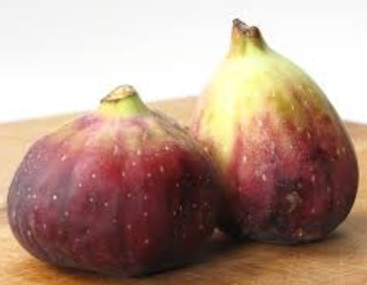
Generation Game Conveyor Belt
Figs

Slide 67
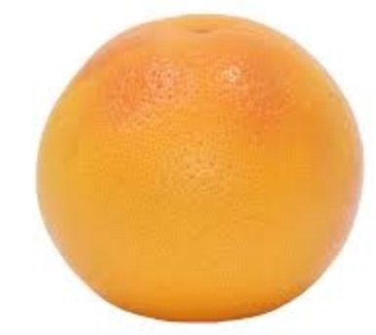
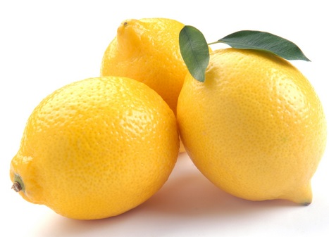
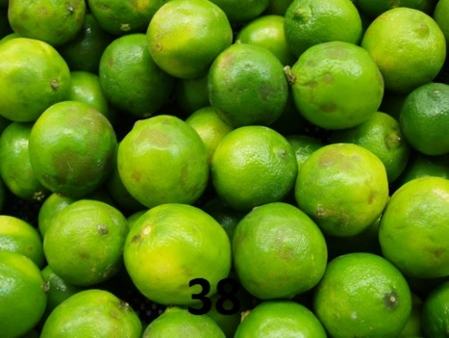
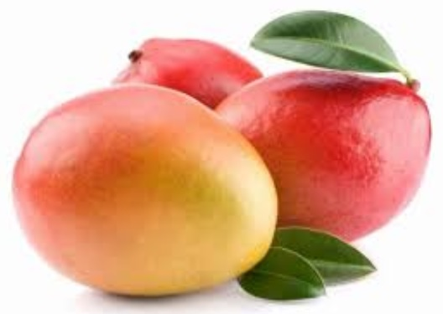
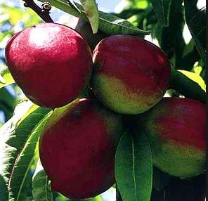
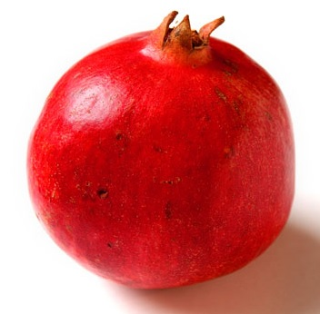
Generation Game Conveyor Belt
Grapefruit | Lemons | Limes
Mangoes | Nectarines | Pomegranate

Slide 68
Generation Game Conveyor Belt
Quince | Rhubarb

Slide 69
Generation Game Conveyor Belt
Sloes | Strawberries
Tangerine | Ugli

Slide 70
Generation Game
Let the thinking commence

Slide 71
Generation Game Conveyor Belt 25 pts each item (25 pt bonus for correct number)
Apples | 7 | Limes | 38
Apricots | 3 | Mangoes | 3
Bananas | 4 | Nectarines | 4
Blueberries | 5 | Pomegranate | 1
Cherries | 7 | Quince | 3
Cuddly Toys | 2 | Rhubarb | 6
Damsons | 3 | Sloes | 11
Figs | 2 | Strawberries | 12
Grapefruit | 1 | Tangerine | 1
Lemons | 3 | Ugli | 2

Slide 72
Target
Did you meet, or even surpass, the target of 3500 points?
Your target in the next round is to get an obscure answer and achieve 500 points.
This gives you an overall target at the end of this round of 4000 points.

Slide 73
Pointless 24th August 2009 - present

Slide 74
British Prime Ministers
Name a British Prime Minister who has been in office since 1900.
The more obscure your answer the more points you will score.
Points from 1 to 500 are available.

Slide 75
Answers
Asquith Hebert | 400 | Douglas-Home Alec | 200
Attlee Clement | 300 | Eden Anthony | 300
Baldwin Stanley | 300 | Gascoyne-Cecil Robert | 500
Balfour Arthur | 400 | Heath Edward | 100
Blair Tony | 10 | Lloyd-George David | 200
Bonar Law Andrew | 400 | MacDonald Ramsay | 400
Brown Gordon | 50 | Macmillan Harold | 100
Callaghan James | 100 | Major John | 50
Cameron David | 10 | Marquess of Salisbury | 500
Campbell-Bannerman Henry | 400 | Thatcher Margaret | 10
Chamberlain Neville | 100 | Wilson Harold | 50
Churchill Winston | 30

Slide 76
Target
Did you meet, or even surpass, the target of 4000 points?
There are now 7 questions left. For each of the 7 questions 5 possible answers are given. You must choose one of the answers and can gamble up to half the points you own. If correct your score increases by the number of points staked, but giving a wrong answer reduces your points by the amount you staked.
Your target, by the end of the quiz, is 20,000 points.

Slide 77
Winner Takes All 1975 – 1988

Slide 78
7) How many of the following are colleges in Oxford AND Cambridge? Trinity, Jesus, St John’s, Christ’s, Corpus Christi
A | 1
B | 2
C | 3
D | 4
E | 5

Slide 79
7) How many of the following are colleges in Oxford AND Cambridge? Trinity, Jesus, St John’s, Christ’s, Corpus Christi
A | 1
B | 2
C | 3
D | 4
E | 5

Slide 80
6) What is the TOTAL number of letters in these Shakespeare plays beginning with T?
THE …… …. …. …..W
T…..S A………………S
T……………. AND …………………A
T………… ……..T
THE …………….. ………E
A | 77
B | 78
C | 79
D | 80
E | None of these

Slide 81
6) What is the TOTAL number of letters in these Shakespeare plays beginning with T?
THE TAMING OF THE SHREW (19)
TITUS ANDRONICUS (15)
TROILUS AND CRESSIDA (18)
TWELFTH NIGHT (12)
THE WINTERS TALE (14)
A | 77
B | 78
C | 79
D | 80
E | None of these

Slide 82
5) How many of these African countries are landlocked? Chad, Kenya, Niger, Sudan, Zambia
A | 1
B | 2
C | 3
D | 4
E | 5

Slide 83
5) How many of these African countries are landlocked? Chad, Kenya, Niger, Sudan, Zambia
A | 1
B | 2
C | 3
D | 4
E | 5

Slide 84
4) In which modern day country was the ancient city of Carthage located?
A | Tunisia
B | Iraq
C | Iran
D | Egypt
E | Libiya

Slide 85
4) In which modern day country was the ancient city of Carthage located?
A | Tunisia
B | Iraq
C | Iran
D | Egypt
E | Libiya

Slide 86
3) How many of the following are spelt correctly? BELLWEATHER DUMBELL MISSPELL INNOCULATE SUPERCEDE
A | 1
B | 2
C | 3
D | 4
E | 5

Slide 87
3) How many of the following are spelt correctly? BELLWEATHER (Bellwether) DUMBELL (Dumbbell) MISSPELL INNOCULATE (Inoculate) SUPERCEDE (Supersede)
A | 1
B | 2
C | 3
D | 4
E | 5

Slide 88
2) Which one of the following teams has never won the FA Cup?
A | Birmingham City
B | Blackpool
C | Burnley
D | Cardiff City
E | Charlton Athletic

Slide 89
2) Which one of the following teams has never won the FA Cup?
A | Birmingham City
B | Blackpool 1953
C | Burnley 1914
D | Cardiff City 1927
E | Charlton Athletic 1947

Slide 90
1) If the pop stars shown below were listed in age order, who would be in the middle?
A | Noddy Holder
B | Paul McCartney
C | Mick Jagger
D | David Bowie
E | Rod Stewart

Slide 91
1) If the pop stars shown below were listed in age order, who would be in the middle?
A | Noddy Holder 15/6/46
B | Paul McCartney 18/6/42
C | Mick Jagger 26/7/43
D | David Bowie 8/1/47
E | Rod Stewart 10/1/45

Slide 92
That’s all folks! Did you meet the demanding target of 20,000 points?
Why not attempt some of the other 10 quizzes on
www.greyhoundderby.com

